Slide 1


Prediction of death number because of heart disease
Sameer Nepal
DSC 680

Slide 2
Introduction
Linear Regression in Machine Learning analysis is important for evaluating data and establishing a definite relationship between two or more variables. Regression quantifies how the dependent variable changes as the independent variable itself take different values.
A Linear Regression model’s main aim is to find the best fit linear line and the optimal values of intercept and coefficients such that the error is minimized.
In this project we are trying to predict the number of death caused by heart disease

Slide 3
Business Problem
Many people die every year because of heart disease, and this can be prevented if people take good care of their health
Predicting the number will give lawmakers overview of how bad the disease is and help motivating people by making some laws for mandatory checkups.
According to the clinical practice guidelines for heart failure, it is recommended to utilize validated risk models to predict prognosis
This is essential in determining appropriate advanced treatments and hospice care by evaluating the accuracy of the models in identifying individuals who are likely to die within the next year

Slide 4
History
One in three adults in California are living with one of the heart diseases. The common forms of cardiovascular disease are heart disease, heart failure, stroke, and high blood pressure
There were 78,000 deaths in 2014 in California and LA county accounted for 15419 deaths.
California Department of Public Health is actively engaged in various initiatives and endeavors aimed at enhancing cardiovascular health throughout the state
Their focus is on endorsing evidence-based programs that encourage healthy behavior and foster healthy communities

Slide 5
Data Description
California government database and it has the information about the death count for different county and reason for death.
Two datasets for the date range of 1999-2013 and 2014- 2021
The data set has been sub categorized by different methods like sex, religion and many more.
I have performed the Exploratory data analysis to extract the data for LA county death every year caused by heart disease.

Slide 6

Exploratory Data Analysis ( EDA )
Python was used to perform EDA
Two data set were merged to get the records from 1999-2021. The resulting datasets had 12 columns and around 400k records
Extracted the data for LA county for the number of deaths that was caused by heart failure
The scatter plot between year and number of deaths was studied and the pattern had some linear relationship
Box plot was used to look at the possible outliers
Heat Map was used to see the correlation between the dependent and independent variable

Slide 7
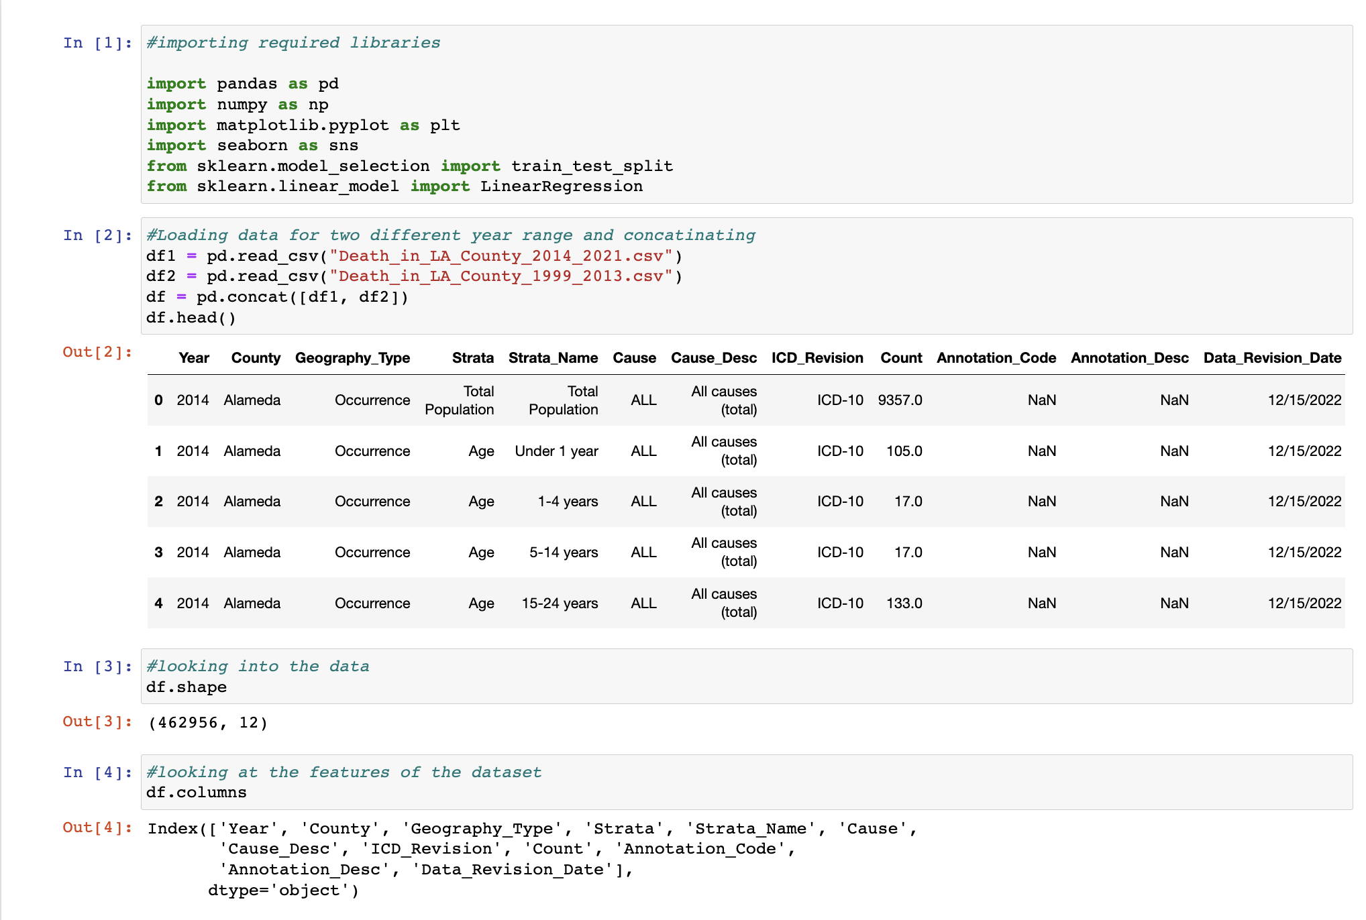
Code Snippet

Slide 8
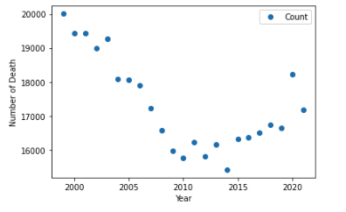
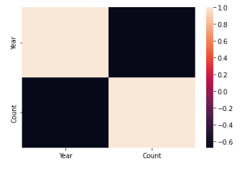
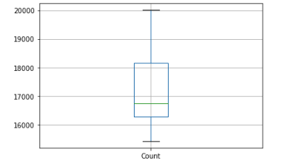
Analysis

Slide 9

Modeling
Regression model was created using the dataset
Divided the data into training and test sets in the ratio of 0.7 and 0.3 respectively and fitted the data to the linear regression model
The MSE and R squared for the model came out to be 643 and 45% respectively.
R squared indicates how close the data is fitted to the regression line. Lower MSE and higher R² value gives us the better model.
The data from 1999-2013 has the decreasing trend in number of deaths whereas the data from 2014-2021 has increasing trend in the number of deaths. This has skewed the distribution of the data when creating the model and hence the accuracy of the model is not very high.

Slide 10
Conclusion
In this project we developed a model that can predict the number of deaths due to heart diseases
Health authorities in LA county to develop strategies on how this can be decreased by making the public aware of healthy habits
In addition, LA County can also share their experiences and lessons learned with other counties in the USA facing similar challenges. By collaborating with other counties, LA County can contribute to the development of evidence-based strategies to prevent deaths and improve health outcomes nationwide.
The accuracy of the model is about 45%. Since the model is generated using the actual data, I recommend using it in predicting the number of deaths in future. This will help the authorities in making necessary policies that will make public aware about the health of heart and its importance for life
Ethical consideration was done when working on this project. Since the data is cumulative count of the people that have died it does not have personal information. It does not have any PII information other than the total number of deaths which are based on different categories like age group, disease, gender. This data is released by the state government, so the ethic has been considered while publishing the data.

Slide 11




Thank you

